Slide 1
Java Open Ended Experiment
BookStore Management
By:
Sourabh Jain - 01FE17BCS214
Sudeep G - 01FE17BCS220

Slide 2
Problem Statement
Create an application in Java for Bookstore Management where the owner can maintain the inventory of items(text books, stationary and newspapers) in the shop and a customer can add different products to their cart and can pay via one of the 3 methods : Cash, Card or Paytm

Slide 3
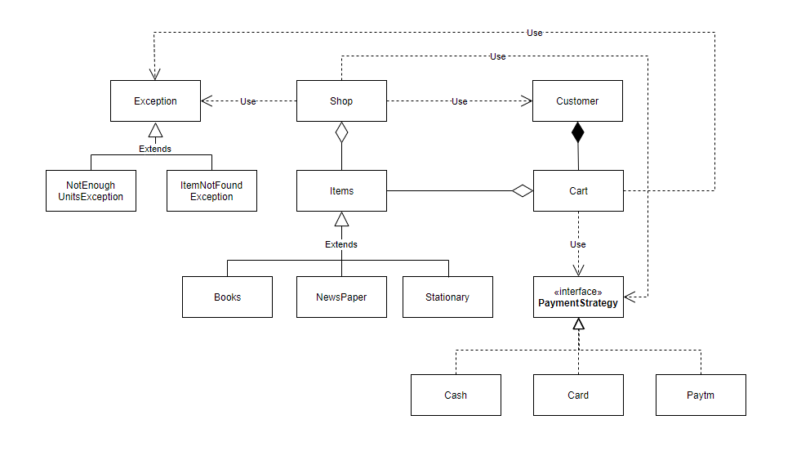
Class Diagram

Slide 4
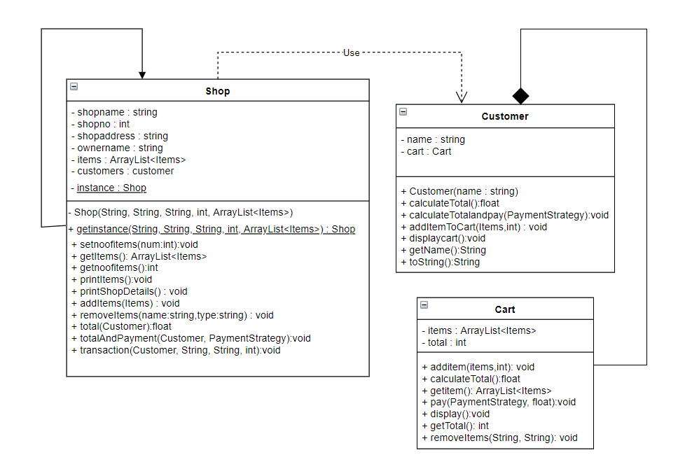
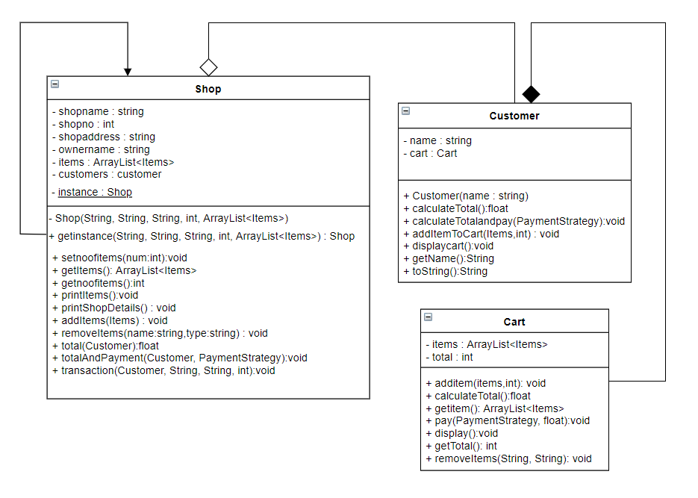

Slide 5
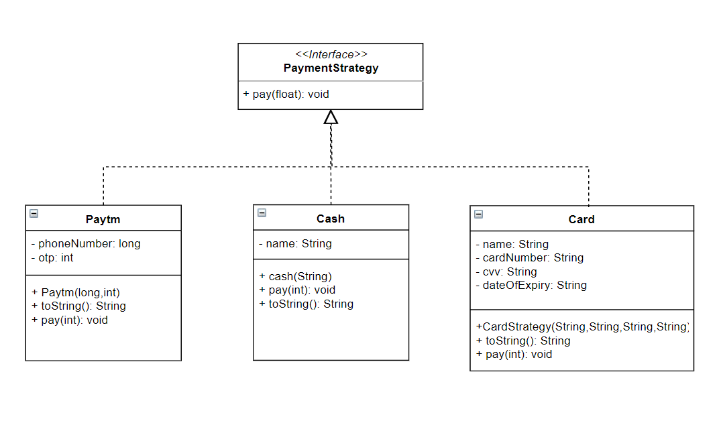

Slide 6
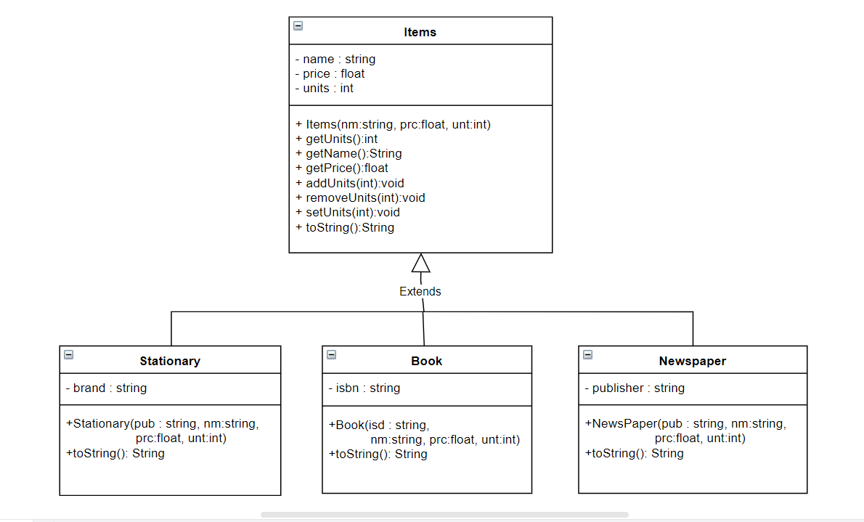

Slide 7
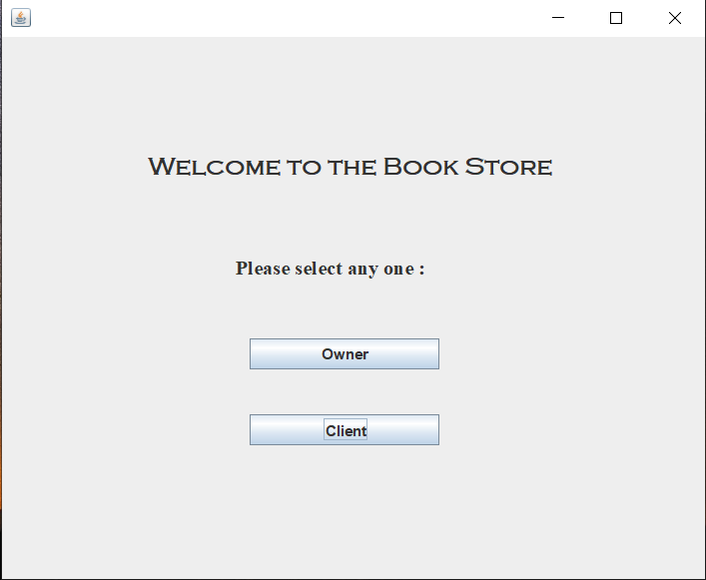
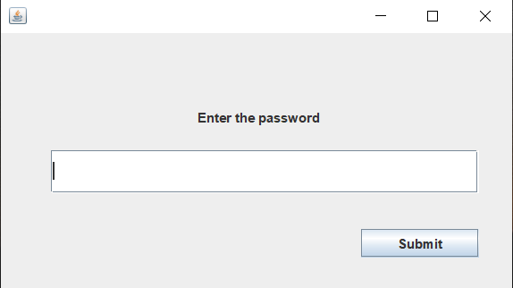
Output
Initial Window
Authentication Window

Slide 8
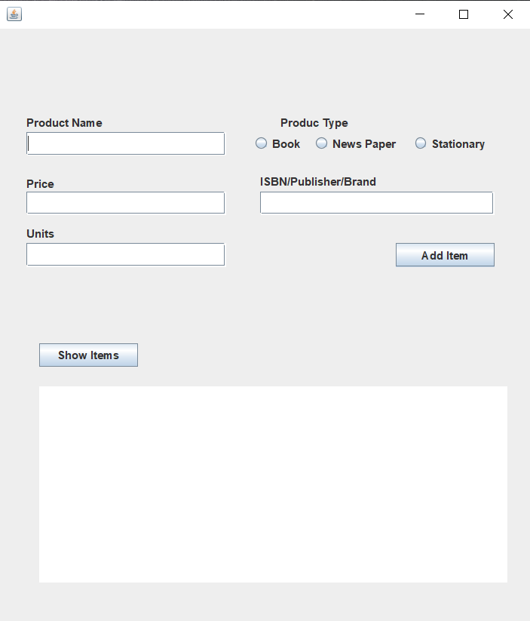
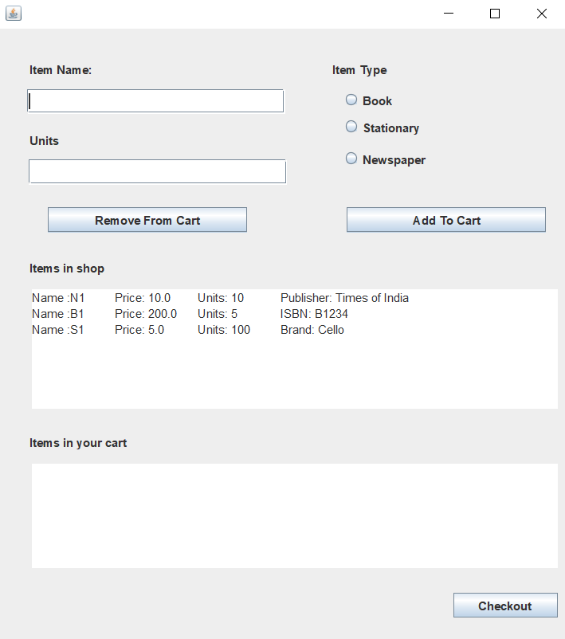
Owner Window
Client Window

Slide 9
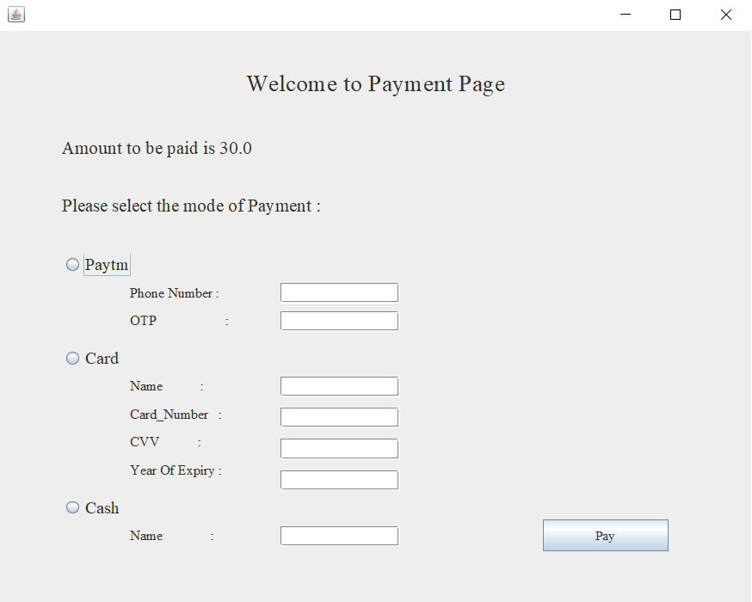
Payment Window

Slide 10
THANK YOU

